Slide 1
H&M WEBSITE CSS MAPPING

Slide 2
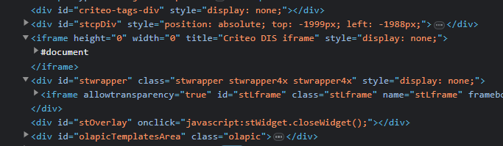
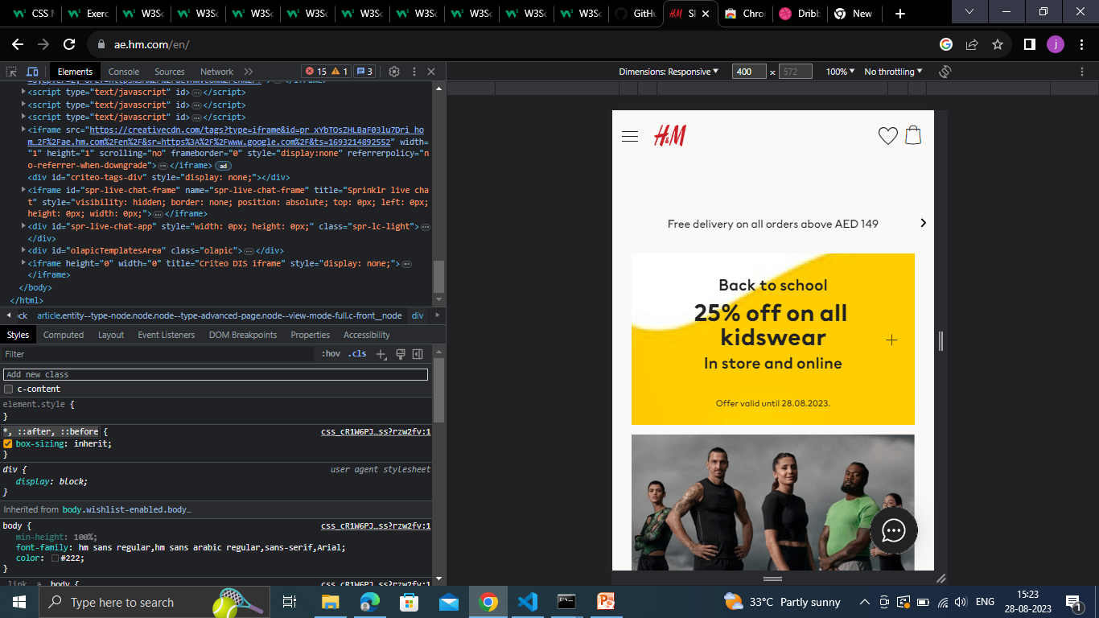
SELECTORS

Slide 3
PROPERTIES AND VALUES

Slide 4
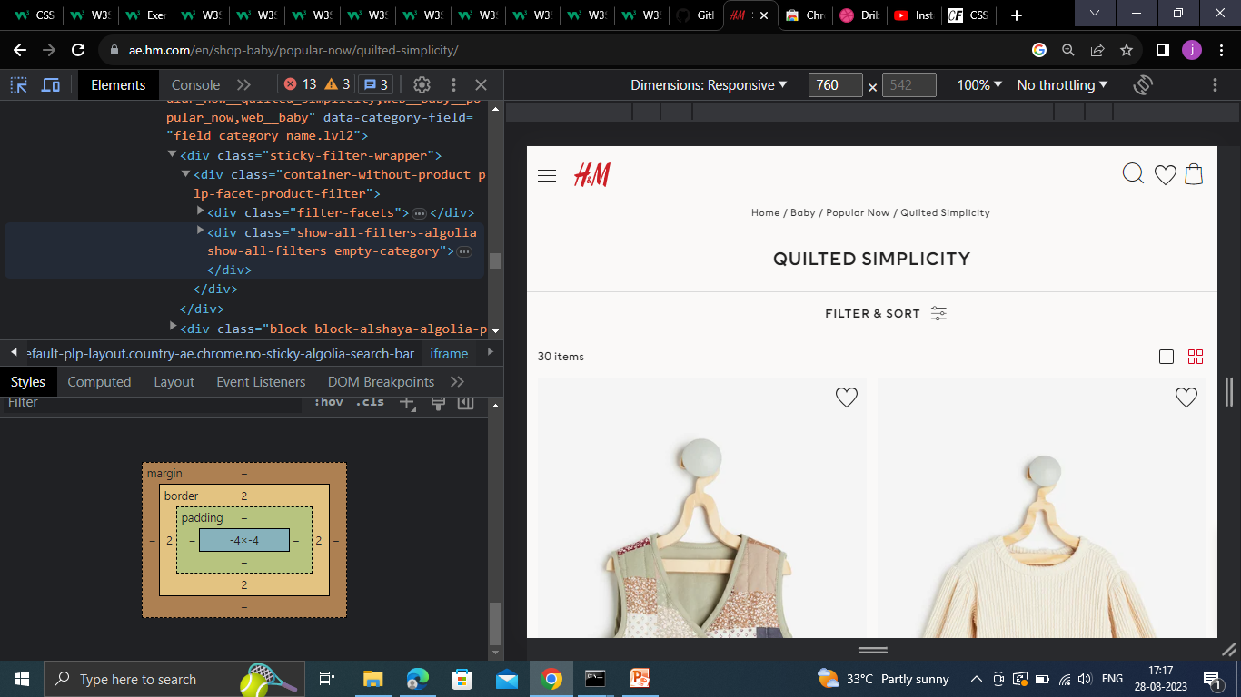
BOX MODEL

Slide 5
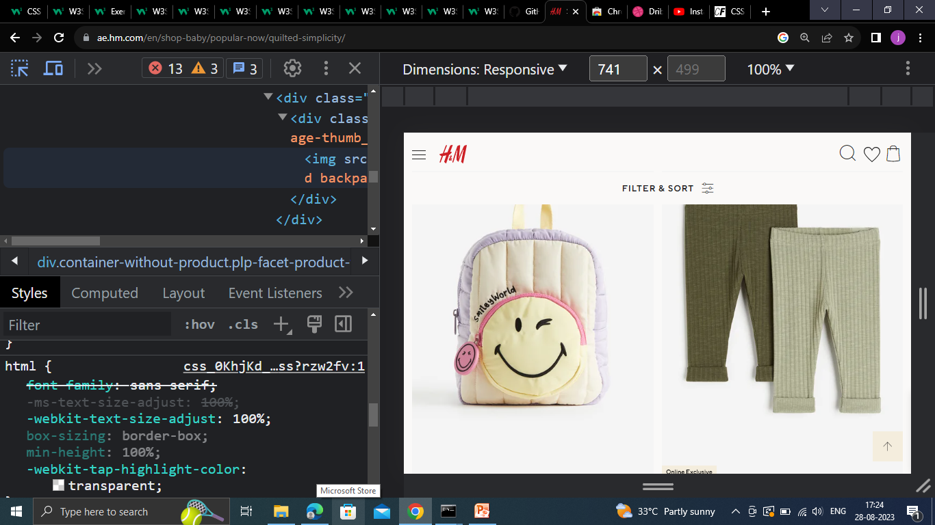
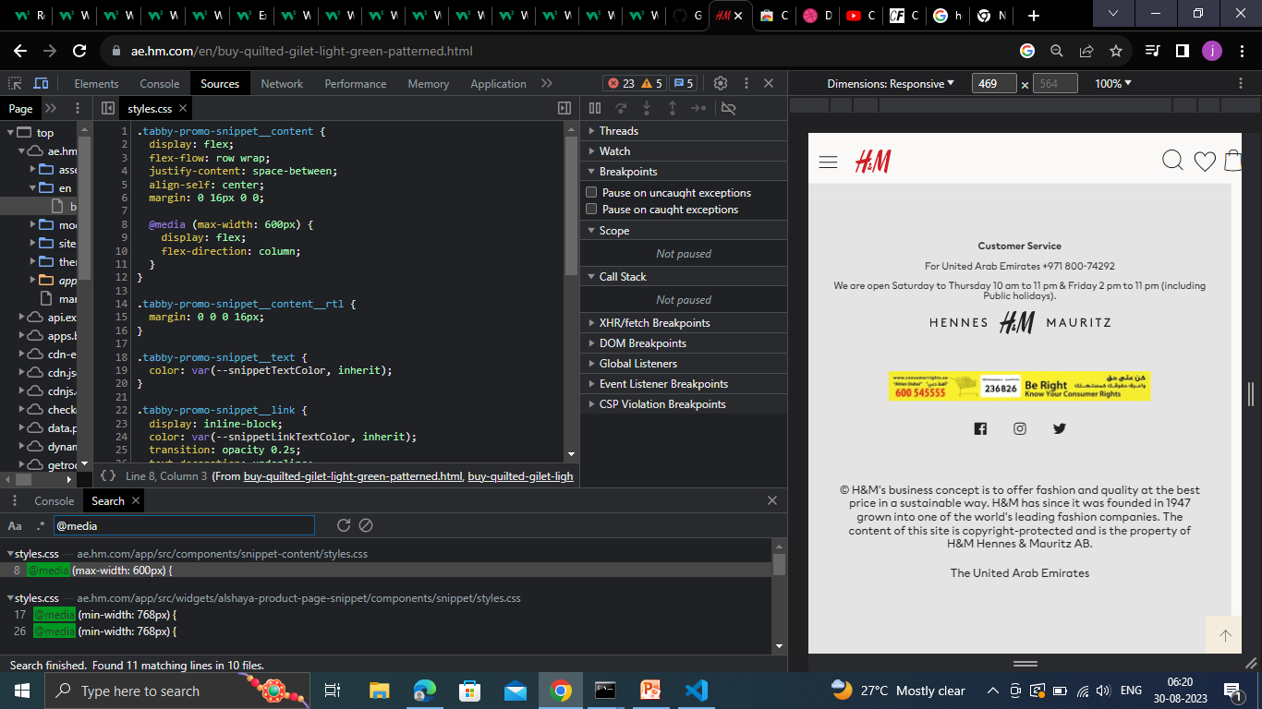
Unit of measurement and responsive design

Slide 6
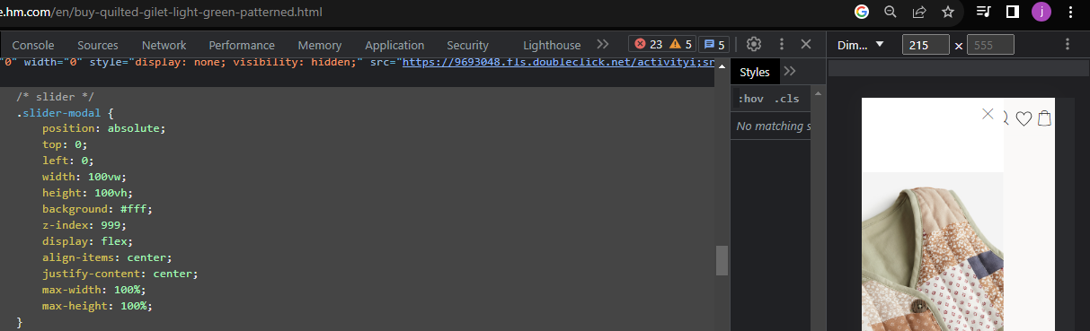
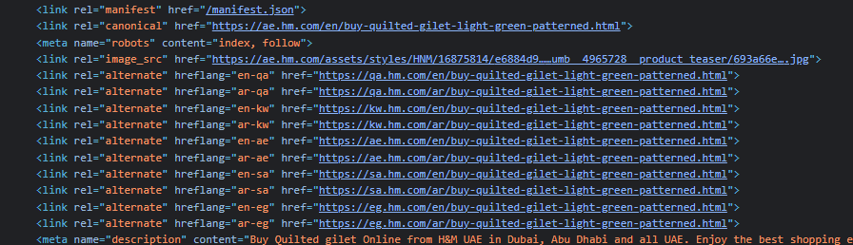
INTERNAL CSS
EXTERNAL CSS

Slide 7
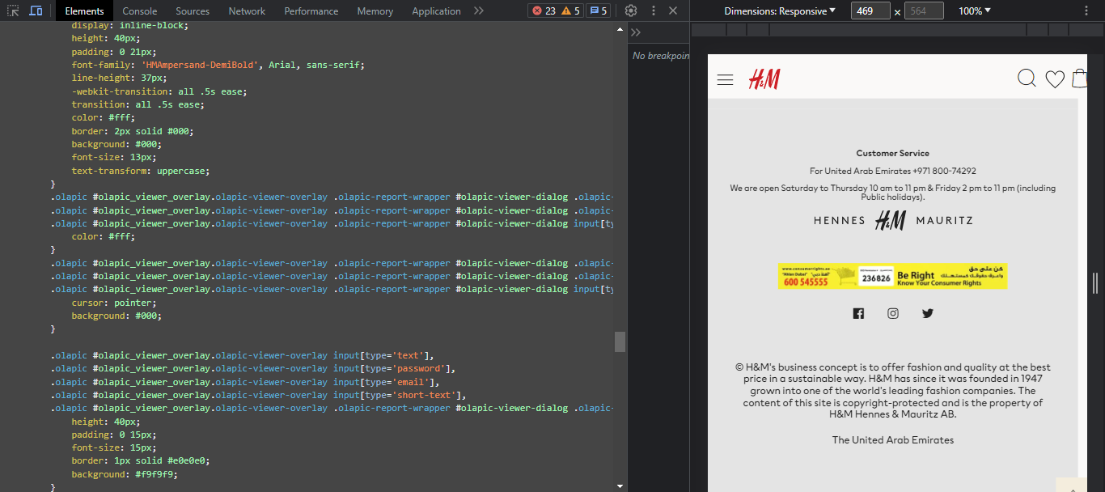
Fonts and colors

Slide 8
Pseudo-classes and Pseudo-elements
Pseudo-element

Slide 9
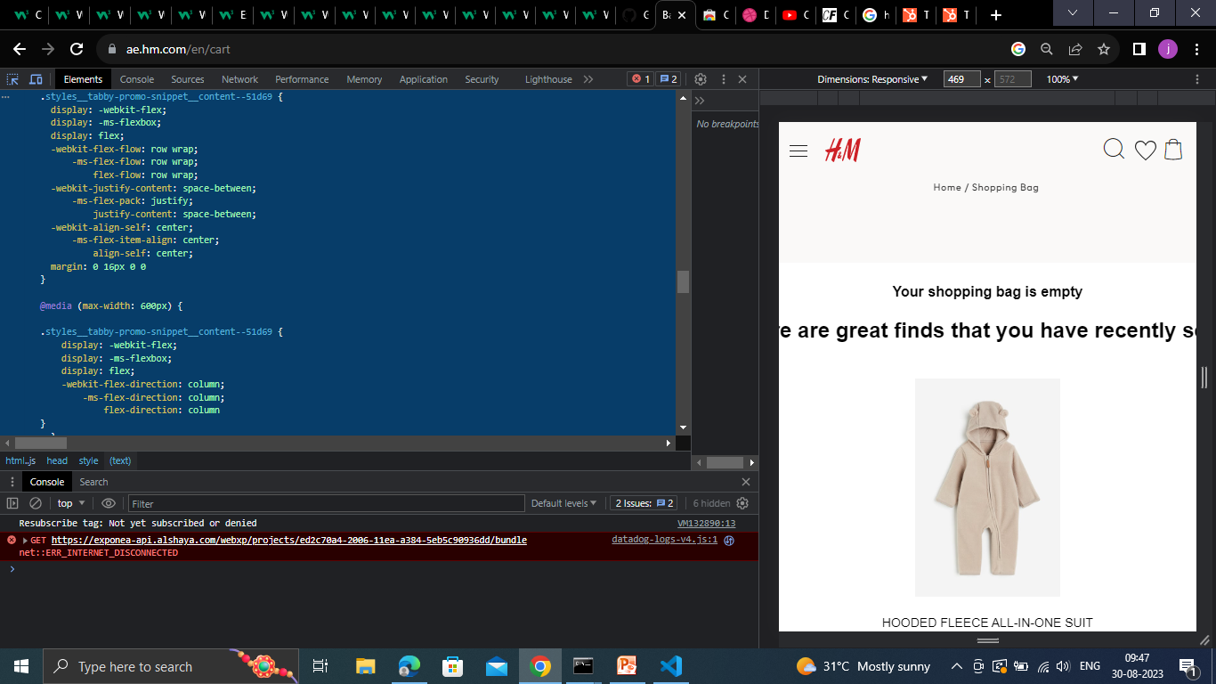
Vendor Prefixes

